Slide 1
Accelerating Electromagnetic Wave Simulation with GPU-Implemented FDTD
By: Zulfiqar Mohammadi
Supervisors: Thomas Woolford and Olaf Maennel

Slide 2

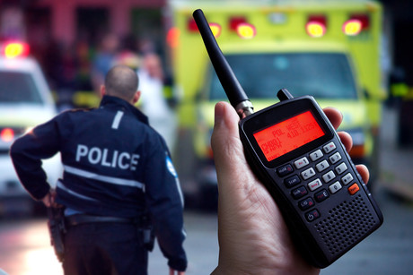
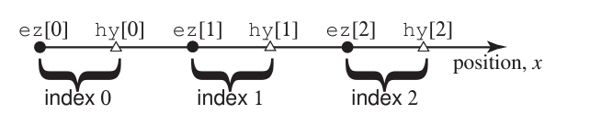
Introduction
Problem: Emergency services struggle due to slow radar simulations, hindering communication and coordination during major incidents or disasters (Figure 1).
The Finite Difference Time Domain (FDTD) method is more efficient algorithm (Figure 2)
Despite its effectiveness, FDTD presents significant computational demands.
Employing GPU implementation to alleviate computational burden.
Why GPU? Because Utilising GPU for parallel execution significantly accelerates task completion, improving efficiency.
Objectives:
Implement 2D FDTD algorithm on a GPU.
Analyze and document performance/accuracy trade-offs of FDTD method on GPU
Figure 1: Emergency services encountering difficulties in communication
Figure 2: Basic Idea of 1D FDTD Algorithm (Schneider, 2010)

Slide 3

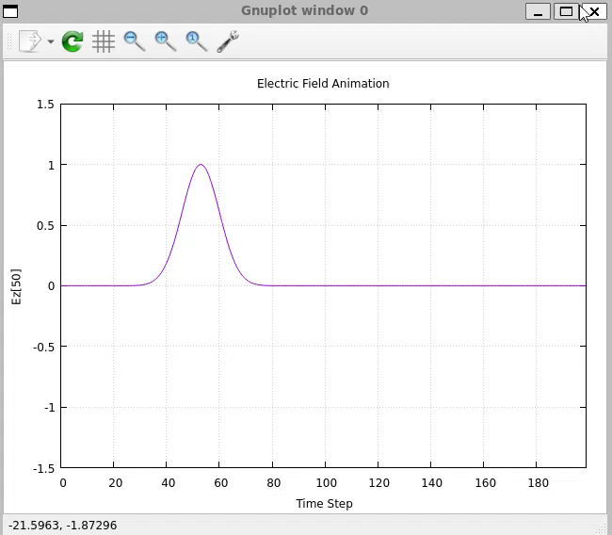
Progress to date
First Results:
Understanding FTDT algorithm
Basic understanding CPU and GPU architectures
Implementation of 1D FDTD in C++.
Visualization of the data output of 1D FDTD with GNU plot library
Basics of thread parallelization in OpenMP
First Challenges:
Balancing Workload Distribution between CPU and GPU.
Algorithm Optimization for GPU Parallel Processing.
Managing GPU Memory Limitations and Optimization
Strategies for challenges
Utilize synchronization mechanisms and load balancing strategies (Demir, V 2014).
Study OpenMP programming for GPU algorithm optimization
Explore memory management techniques (memory pooling, data compression) (Morunov, ND & Golovashkin, DL 2019).
Figure 3: Electric Field Animation of FDTD algorithm in GNU Plot library (Click to play animation) (link in the appendix)

Slide 4


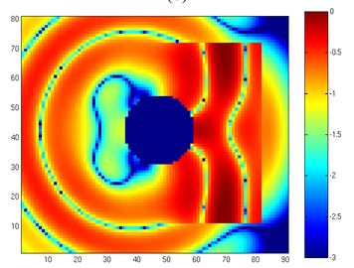
Project Success: Key Considerations
Successful if
GPU simulation runtime is faster than CPU runtime.
Identify and document the tradeoff and obstacles
Functionality evaluation:
No relevant dataset comparison; focus on process intricacies.
Identify challenges in algorithm design and implementation.
Document obstacles encountered and solutions devised.
Experiment overview
Simulation of radar propagation through diverse mediums: vacuum and air.
Study of wave diffraction upon encountering ground-based constraints (Figure 5).
Measurement parameters comprise CPU and GPU clock speeds and instruction count. (optional: per-thread GPU runtime)
Figure 4: project success considerations
Figure 5: wave diffraction upon encountering ground-based constraints in 2D

Slide 5

References
Lively, S. David, "GoLightly : A GPU Implementation of the Finite-Difference Time-Domain Method" (2022). Electrical Engineering Theses and Dissertations. 54.
Ying Xu, Huimin Ma & Rongling Jiang 2016, ‘Collaborating CPU and GPU for the electromagnetic simulations with the FDTD algorithm: COLLABORATING CPU AND GPU FOR FDTD ALGORITHM’, Concurrency and Computation, vol. 29, pp. e3859-.
John B . Schneider 2010, “Understanding the Finite-Difference Time-Domain Method”” https://eecs.wsu.edu/~schneidj/ufdtd/”.
Meng, H-T, Nie, B-L, Wong, S, Macon, C & Jin, J-M 2014, GPU accelerated finite-element computation for electromagnetic analysis, IEEE antennas & propagation magazine, vol. 56, IEEE, PISCATAWAY, no. 2, pp. 39–62.
Chi, J, Liu, F, Weber, E, Li, Y & Crozier, S 2011, ‘GPU-Accelerated FDTD Modeling of Radio-Frequency Field-Tissue Interactions in High-Field MRI’, IEEE Transactions on Biomedical Engineering, vol. 58, no. 6, pp. 1789–1796.
Demir, V 2014, ‘A simple GPU implementation of FDTD/PBC algorithm for analysis of periodic structures’, Applied Computational Electromagnetics Society Journal, vol. 29, no. 12, pp. 1018–1024.
Morunov, ND & Golovashkin, DL 2019, ‘Design features of block algorithms of FDTD-method implemented on a GPU using MATLAB’, Kompʹûternaâ Optika, vol. 43, no. 4, pp. 671–676.

Slide 6
THANK YOU

Slide 7
Appendix
1. Link to my GitHub FDTD repository
https://github.com/Zulfi12345/FDTD.git

